Slide 1
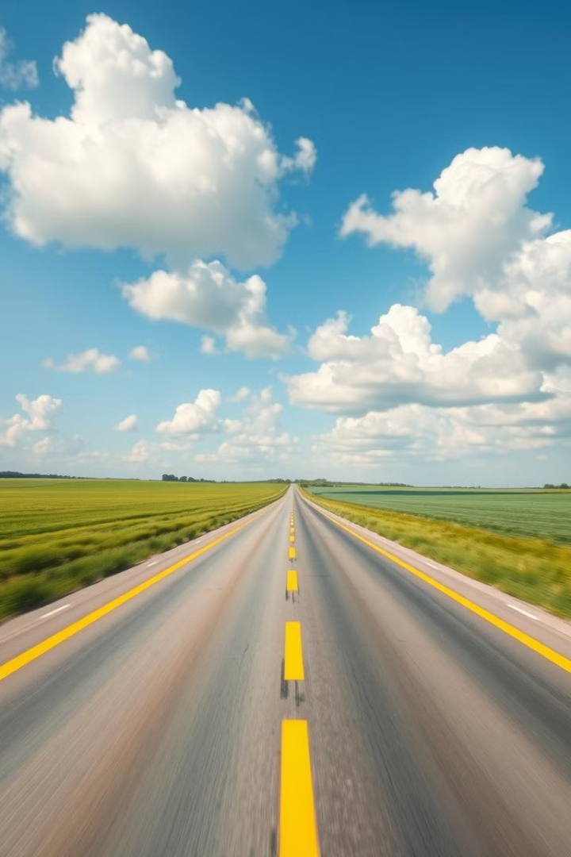

AI-Driven Highway Inspection and Maintenance System.
This presentation details a deep learning solution for automating road safety inspections, saving time and money while improving road safety in India.

Slide 2

Team Member
Aathisakthi G
AI and Data Science Aspirant
https://www.linkedin.com/in/aathisakthi-g

Slide 3

Project Leadership
Pitabasa Mohapatra
Associate Data Scientist
linkedin.com/in/pitabasa-mohapatra-a10b29188

Slide 4
Contents
Business problem
Business Objectives and Constraints
System Architecture
CRISP-ML(Q)
Prerequisites
Data Collection & Preprocessing
Model Training and Evaluation
Visualization
Deployment
Conclusion: Towards a Safer Future

Slide 5

Business Problem
The client, a highway maintenance contractor, faces challenges in ensuring road safety due to manual inspections being time-consuming, costly, and prone to errors. Delays in defect identification, such as faded lane lines or damaged barriers, increase safety risks. Implementing AI can automate inspections, enhance accuracy, and speed up maintenance, reducing costs and improving safety.

Slide 6
Project Objectives and Constraints
Business Objectives
Business Constraints
Automate road safety inspections using deep learning models for faster and more efficient analysis.
Ensure high scalability to handle diverse highway conditions and varying traffic volumes.
Detect and segment damaged road safety features, including lane lines, crash barriers, stop signs, and mile markers.
Maintain high performance for real-time object detection and segmentation for timely and accurate insights.
Reduce manual inspection costs by leveraging AI-powered solutions for highway maintenance.

Slide 7
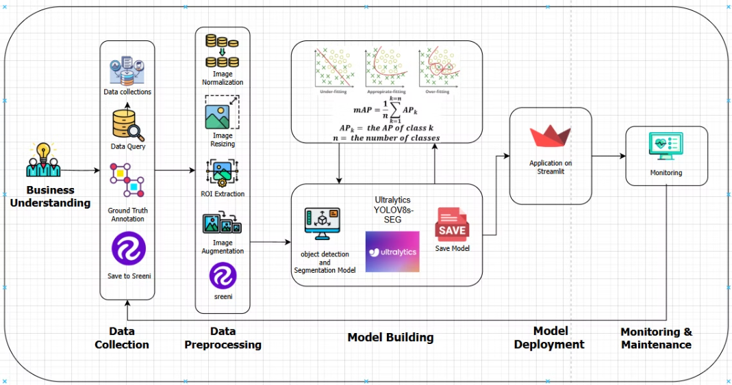
System Architecture
Input Data
High-resolution images and videos from highway cameras. In this case, were fetched from web.
Processing Unit
YOLOv8s-seg model trained for object detection and segmentation.
Output
Detection reports with identified safety issues.

Slide 8
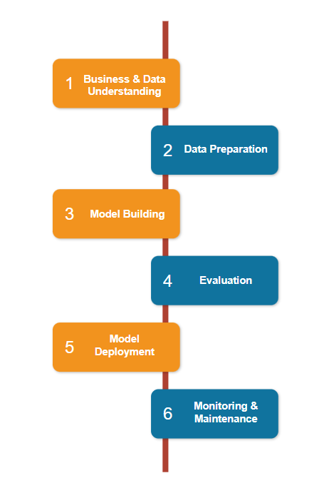
CRISP- ML(Q)
1. Business & Data Understanding
Objective: Automate highway inspections to reduce costs and improve scalability.
Data Source: Web-scraped images (Google, Shutterstock, etc.).
2. Data Preparation
Annotation & Augmentation: Processed in Digital Sreeni.
Preprocessing: Converted to YOLO format using Python scripts.
3. Model Building
Model Used: YOLOv8s-seg for object detection and segmentation.
4. Evaluation
Metric: Mean Average Precision (mAP) for performance assessment.
5. Model Deployment
Format: Saved in ONNX for efficient inference.
Application: Deployed using Streamlit.
6. Monitoring & Maintenance
Continuous Updates: Performance tracking, retraining with new data.
Scalability: Optimized for real-world deployment and adaptation.

Slide 9

Prerequisites
📌 Programming & Libraries
Python (Primary language) | NumPy, Pandas (Data handling)
Keras (High-level API for TensorFlow)
📌 Dataset & Annotation
COCO JSON format (Instance segmentation)
Digital Sreeni (Annotation & Augmentation)
📌 Model & Frameworks
YOLOv8s-seg | PyTorch / TensorFlow (Deep learning frameworks)
OpenCV (Image & video processing) | Keras (TensorFlow API)
📌 Evaluation & Visualization
Metrics : mAP (Mean Avg Precision), IoU (Intersection Over Union)
Tools : Matplotlib, Seaborn (Performance visualization)
📌 Deployment
Stream lit (Web app for real-time inference)

Slide 10
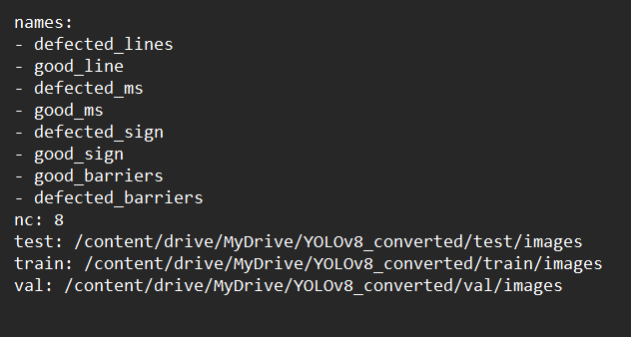
Data Collection & Preprocessing
Data Collection
Data Preprocessing
Leveraging highway monitoring cameras for continuous data acquisition.
Employing the Sreeni App for efficient annotation and augmentation of data.
Utilizing pre-annotated datasets of highway images and videos to accelerate training.
Cleaning the dataset by removing low-quality images to improve model accuracy.
Standardizing pixel values and normalizing polygon coordinates for consistent data input.
Formatting images, labels, and YAML files to be compatible with YOLOv8s-seg.

Slide 11
Model Training and Evaluation
Model Training
Evaluation
YOLOv8s-seg, a state-of-the-art model for real-time semantic segmentation.
Key metrics: mAP (Mean Average Precision), IoU (Intersection over Union), and F1-score.
Training environment: Google Colab (T4 GPU recommended) for efficient computation.
Achieved high performance with an mAP of 93% and a best IoU of 0.85.
Key Components in YOLOv8s-seg:
📌 Backbone (CSPDarkNet) – Extracts deep spatial features.
📌 Neck (BiFPN or PANet) – Refines multi-scale feature maps for better detection.
📌 Detection Head – Outputs bounding boxes and class confidence scores.
📌 Segmentation Head – Generates pixel-wise masks for detected objects.

Slide 12
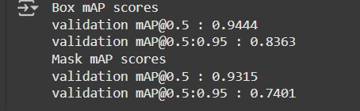
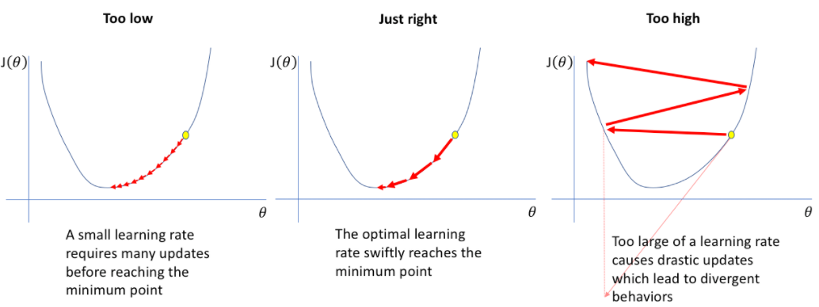
Model’s performance
Model’s performance is based on mAP score we get once after the traning and in this YOLOv8s-seg which is kinda combination of both object detection and segmentation models so we have to consider the mAP of different IOU levels and mAP of both the bounding boxes of object detection model (B) and the mask of segmentation model (M) .
The model also provides insights into precision and recall, which contribute to the F1 score—another performance evaluation metric. However, since mAP (Mean Average Precision) is the primary metric for this model, the F1 score is not explicitly used for evaluation.
The learning rate (lr0) and the number of epochs are two critical parameters in model training. They play a key role in determining the model's accuracy by guiding the optimization process—helping the model transition from local position to global or local minima to reduce loss function, ensuring better convergence and performance.

Slide 13
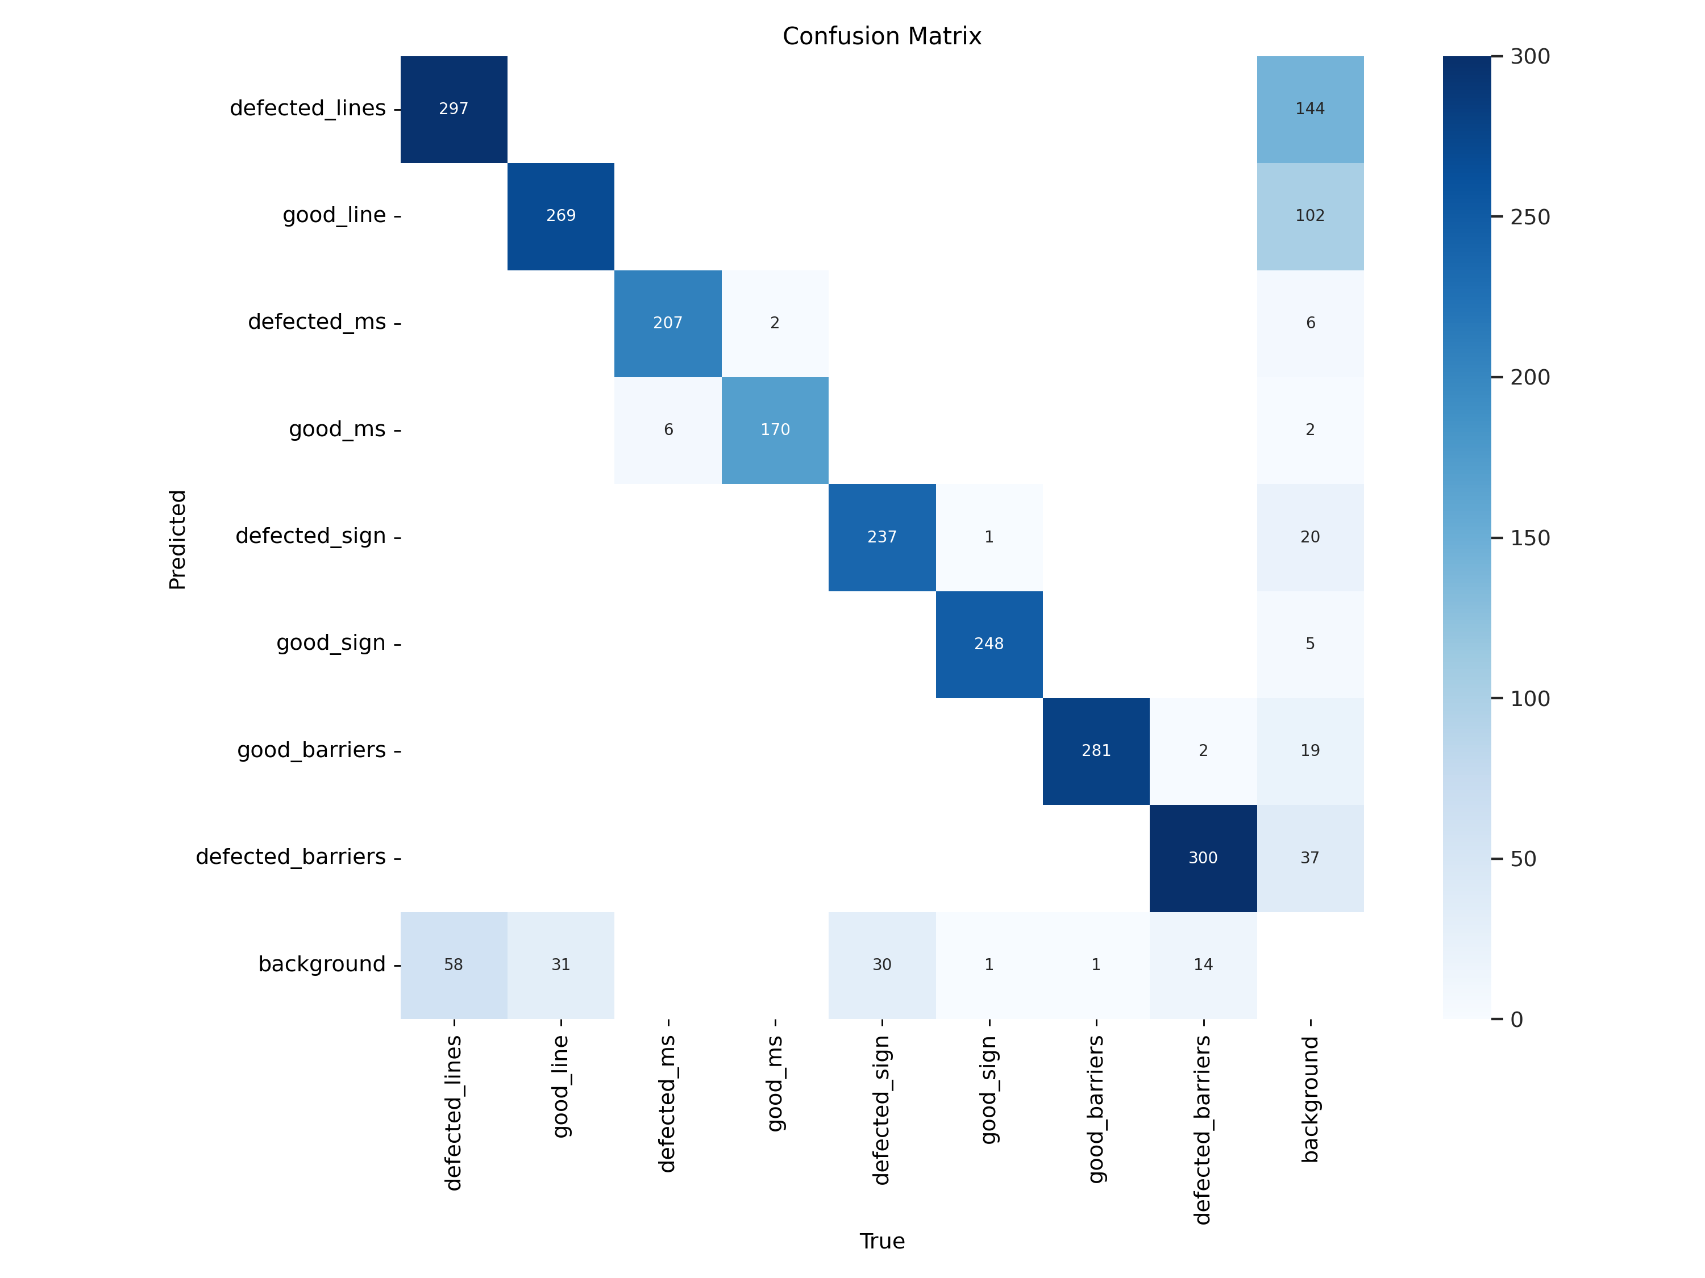
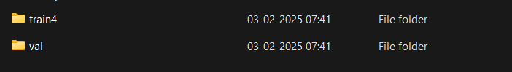
visualizations
Confusion matrix in training
Pretrained model like YOLO supports the visualization implicitly without being explicitly used in the code and still let us to use val() function to gain some insights .
When we say about implicitly ,model generate visuals at the backend which frontend focus on training and these visuals are stored in train and val folders in run folder with best weights saved as best.pt which is morethan enough to use the model during deployment .
In my case these are the folder generated by YOLOV8s-seg ,which consist of various visual insights .

Slide 14
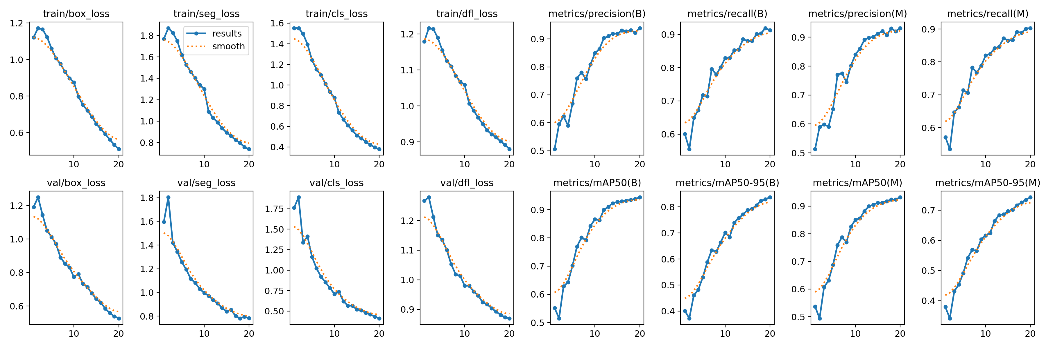
visualizations

Slide 15
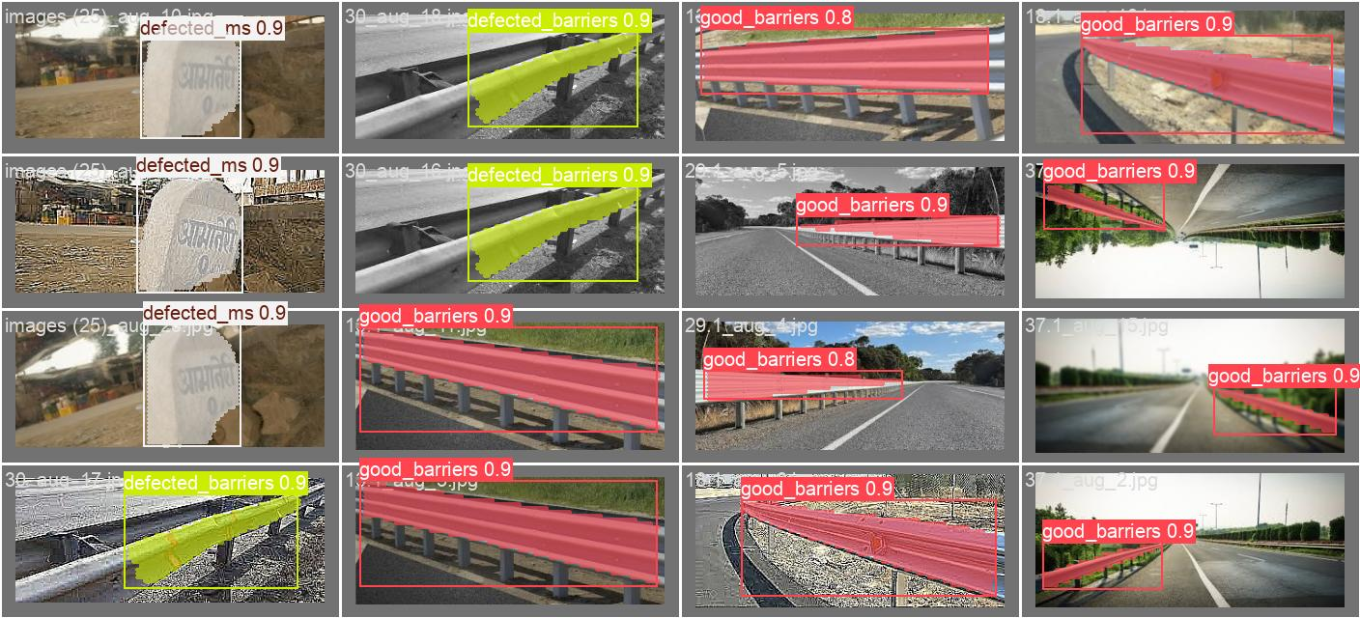
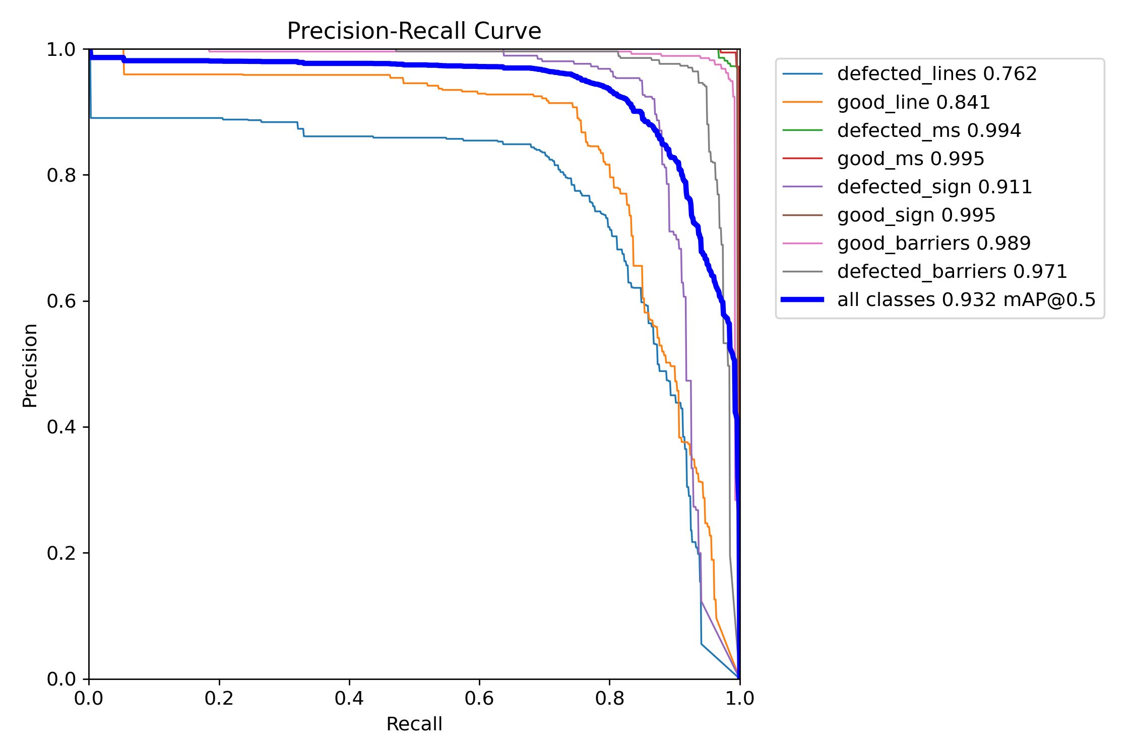
visualizations

Slide 16




Deployment
Real-time Detection
Streamlit Dashboard
Inference Pipeline
Live detection on images and videos offers immediate insights via OpenCV.
An interactive web interface visualizes results for user-friendly access.
OpenCV enables real-time predictions for efficient and timely processing.

Slide 17
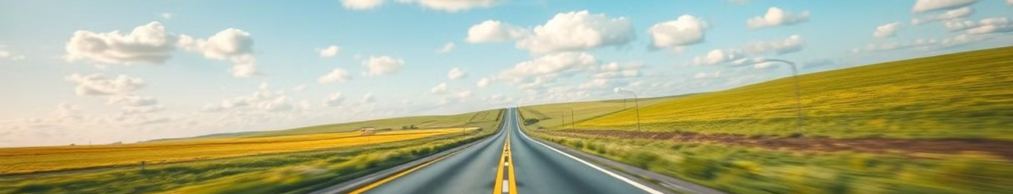
Conclusion: Towards a Safer Future
1
Automated & Scalable
2
Cost-effective
This deep learning solution provides an automated and scalable solution for road safety inspections.
Reducing manual inspection costs and improving the efficiency of road maintenance.
3
Enhanced Road Safety
4
Long-term Reliability
Accelerated defect detection leads to faster repairs and a safer driving environment.
Continuous monitoring and model updates ensure long-term reliability and adaptability.

Slide 18

Queries ?
Pitabasa Mohapatra
Associate Data Scientist
linkedin.com/in/pitabasa-mohapatra-a10b29188

